Slide 1
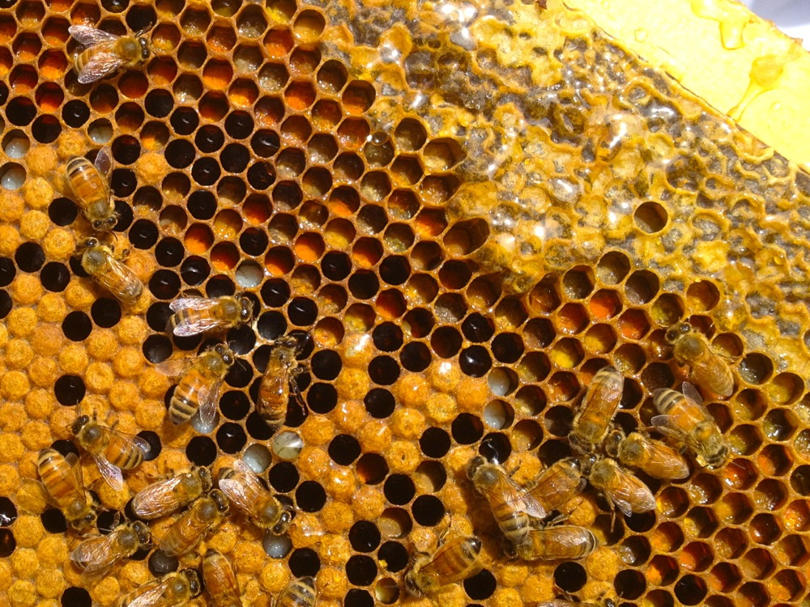
Axelrod’s Tournament

Slide 2
Cooperation is Everywhere. But Why?
Courtesy: milkwood.net

Slide 3
… But Why?!
Imagine a population of cooperating individuals.
A non-cooperator joins them and gets the benefits of cooperating without having to do any work!
The non-cooperator and its descendants are more fit for survival, and non-cooperation is rampant.
So how can we account for cooperation?

Slide 4
“Prisoner’s Dilemma”
 |  | Partner’s decision
 |  | Cooperate | Defect
Your decision | Cooperate | 1 year | 10 years
 | Defect | 0 years | 7 years
Prisoner’s Dilemma: You and accomplice are locked in different rooms. You get different sentences based on what you do ...

Slide 5
“Prisoner’s Dilemma”
 |  | Partner’s decision
 |  | Cooperate | Defect
Your decision | Cooperate | 1 year | 10 years
 | Defect | 0 years | 7 years
Prisoner’s Dilemma: You and accomplice are locked in different rooms. You get different sentences based on what you do ...
STOP What incentive do you have to cooperate?

Slide 6
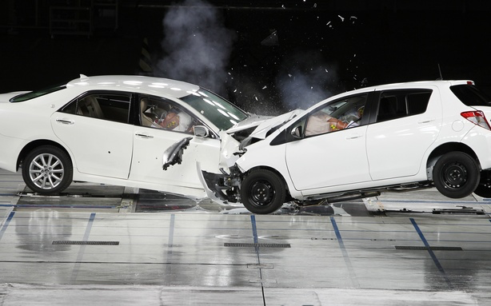
“Chicken”
Courtesy: theatlanticwire.com
Exercise: What might the “payoff matrix” be?

Slide 7
“Chicken”
 |  | Opponent’s decision
 |  | Swerve | Straight
Your decision | Swerve | 0 | -1
 | Straight | +1 | -8924894
STOP How does this differ from Prisoner’s Dilemma?

Slide 8
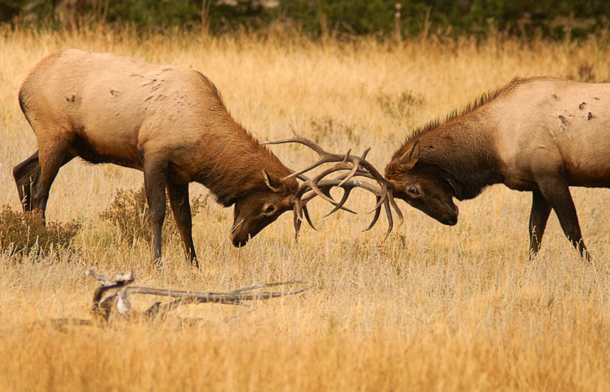
“Hawk-Dove”
Courtesy: John de Bond
Exercise: What might the “payoff matrix” be?

Slide 9
“Hawk-Dove”
 |  | Opponent’s decision
 |  | Back down | Fight
Your decision | Back down | V/2 | 0
 | Fight | V | V/2 – C
V = mating benefit
C = injury cost
STOP How does Hawk-Dove compare to Chicken?

Slide 10
Game Theory
This is just the beginning of a huge area of research called game theory: the study of strategies of interaction.
Game theory has been applied to psychology of relationships, biology, international relations, etc.

Slide 11
Example: Nuclear Armament
STOP What two-player “game” might model this?

Slide 12
Further Questions for Thought
What happens if there are more than two strategies? Or more than two players?

Slide 13
Further Questions for Thought
What happens if there are more than two strategies? Or more than two players?
What if players can play a mixture of strategies?

Slide 14
Further Questions for Thought
What happens if there are more than two strategies? Or more than two players?
What if players can play a mixture of strategies?
What if the payoffs vary depending on the player?

Slide 15
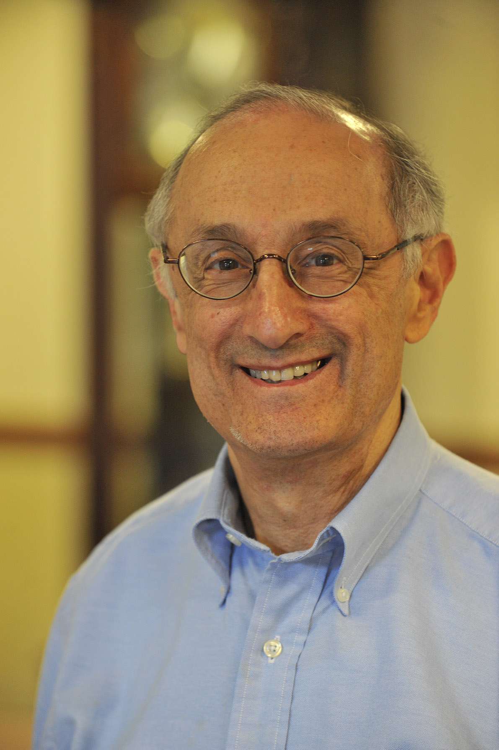
Axelrod’s Tournament (1978)
What if the Prisoner’s Dilemma is played multiple times?
 |  | Partner’s decision
 |  | Cooperate | Defect
Your decision | Cooperate | 5 | 1
 | Defect | 7 | 3
Courtesy: Robert Axelrod
Robert Axelrod

Slide 16
Axelrod’s Tournament (1978)
What if the Prisoner’s Dilemma is played multiple times?
Exercise: Design a strategy for Axelrod’s tournament.
We are playing an (unknown) m number of games.
We don’t know our opponent’s strategy.
We play a variety of opponents but use same strategy.
Courtesy: Robert Axelrod

Slide 17
Break to Play Tournament

Slide 18
Idea 0: “Poor-Trusting Fool”
for every integer i between 1 and m
cooperate!
STOP What are its strengths and weaknesses?

Slide 19
Idea 1: “All-Defect”
for every integer i between 1 and m
defect!
STOP What are its strengths and weaknesses?

Slide 20
Idea 2: “Grudger”
betrayed ← false
for every integer i between 1 and m
if betrayed
defect!
else
if opponent defected in game i - 1
betrayed = true
defect!
else
cooperate!
STOP What are its strengths and weaknesses?

Slide 21
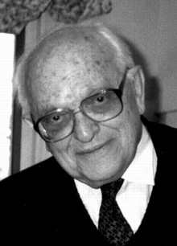
The Clear Winner: “Tit-for-Tat”
cooperate in game 1
for every integer i between 2 and m
do whatever opponent did in game i – 1
This was the winning strategy (and the simplest!) among 15 submissions.
STOP What properties of this strategy make it so good?
Anatol Rapoport

Slide 22
Words to Live By ...
More tournaments have shown that the highest-scoring strategies tend to have four qualities:
Niceness: Never be the first to defect.
Provocability: Get mad quickly at defectors and retaliate.
Forgiveness: Do not hold a grudge once you have vented your anger.
Clarity: Act in ways that are straightforward for others to understand.
http://www2.econ.iastate.edu/classes/econ308/tesfatsion/axeltmts.pdf

